Slide 1


Trait-based ecology & Phytoplankton
Learning goals
Having heard of trait-based ecology
Describe traits in phytoplankton
Explain and give an example of a trade-off in phytoplankton
Dedmer van de Waal
d.vandewaal@nioo.knaw.nl

Slide 2
Trait-based ecology & Phytoplankton
Learning goals
Having heard of trait-based ecology
Describe traits in phytoplankton
Explain and give an example of a trade-off in phytoplankton
Dedmer van de Waal
d.vandewaal@nioo.knaw.nl

Slide 3
Trait-based ecology – Traits
What is a trait?
A characteristic of an (individual) organism
Traits vary between species (interspecific variation), but also within species through variation between genotypes (intraspecific variation) and within a genotype (phenotypic plasticity)

Slide 4
Trait-based ecology – Traits
Why do we study traits?
Traits provide a mechanistic understanding on the interactions in populations, communities and food webs
It is not just about who is in a system, but also about what they (can) do, as this drives seasonal dynamics (competition, facilitation), impacts of climate change (dealing with stressors), and evolution (selection)

Slide 5
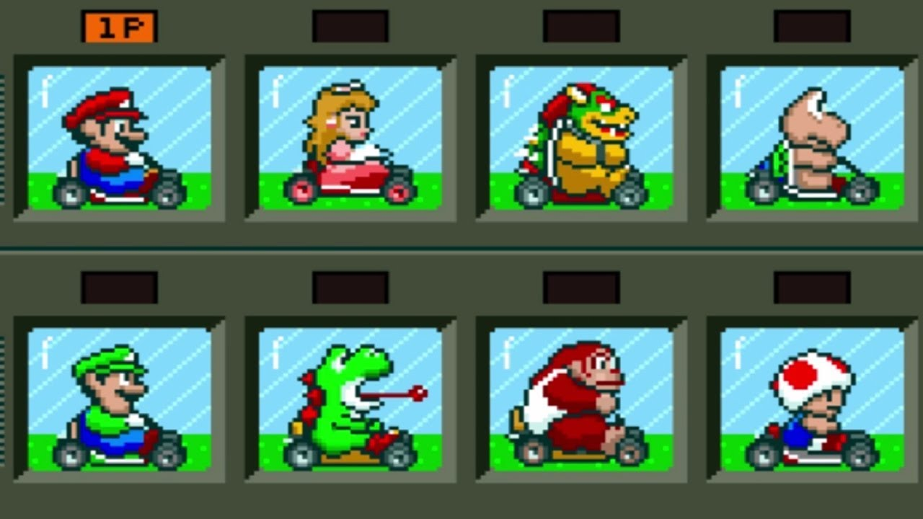
Trait-based ecology – Traits
Example of traits in practice
Fast acceleration
High max speed
From: Mario Kart SNES, Nintento (Shigeru Miyamoto, Tadashi Sugiyama, Hideki Konno)

Slide 6
Trait-based ecology – Trade-offs
Example of traits in practice
Fast acceleration
→ Low max speed
High max speed
→ Low acceleration
From: Mario Kart SNES, Nintento (Shigeru Miyamoto, Tadashi Sugiyama, Hideki Konno)

Slide 7
Trait-based ecology – Trade-offs
Example of traits in practice
Acceleration
Max speed
From: Mario Kart SNES, Nintento (Shigeru Miyamoto, Tadashi Sugiyama, Hideki Konno)

Slide 8
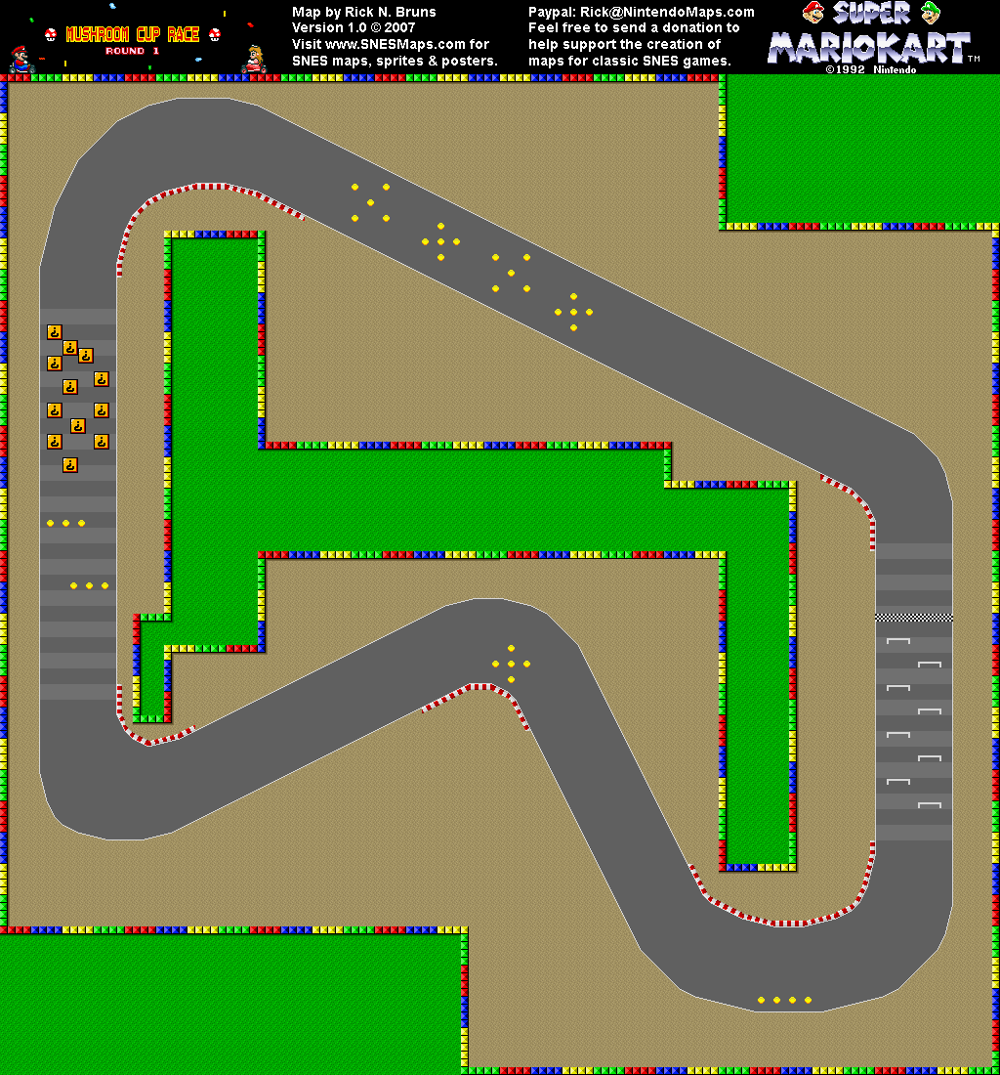
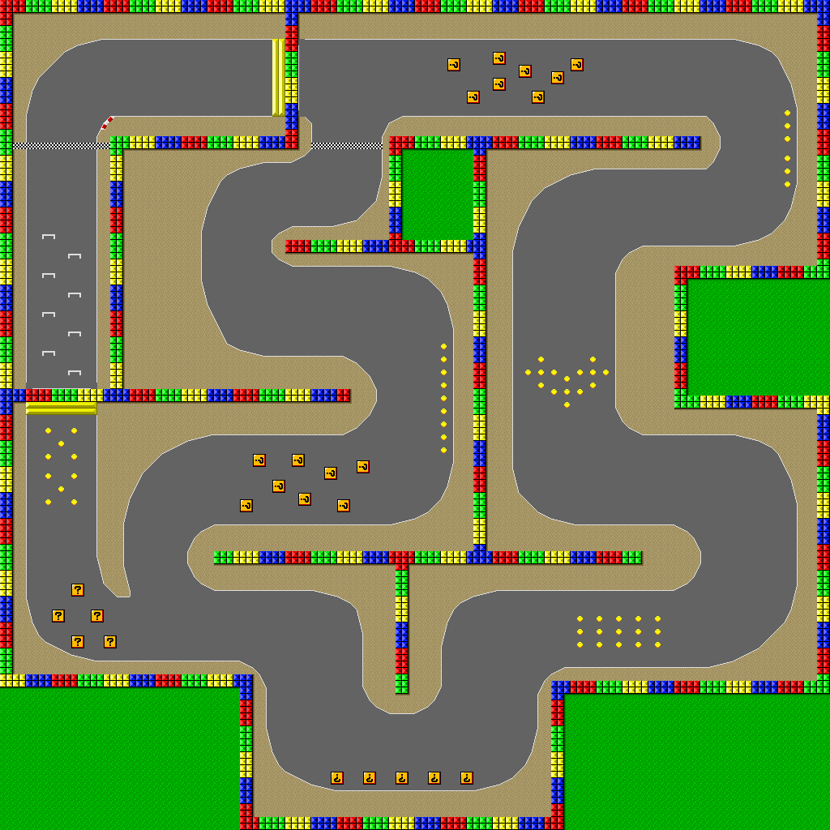
Trait-based ecology – Role of environment
Example of traits in practice
From: Mario Kart SNES, Nintento (Shigeru Miyamoto, Tadashi Sugiyama, Hideki Konno)

Slide 9
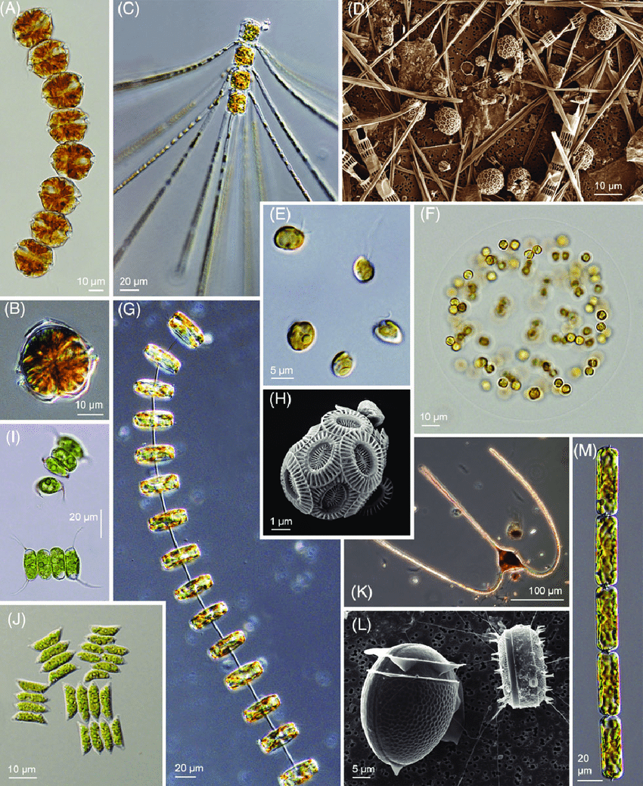
Trait-based ecology – Phytoplankton traits
Which traits help survival, and why?
Pančić & Kiørboe 2018 Biol. Rev

Slide 10
Trait-based ecology – Phytoplankton traits
Question: Which traits help survival, and why?
Chain
Toxins
Colony
Flagellum
Chlorophyll-a
Spikes
Large cell
Mixotrophy
Filament
Pančić & Kiørboe 2018 Biol. Rev

Slide 11
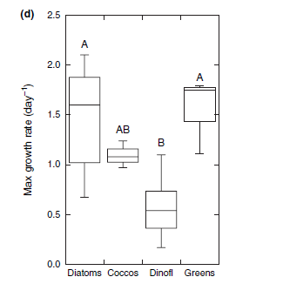
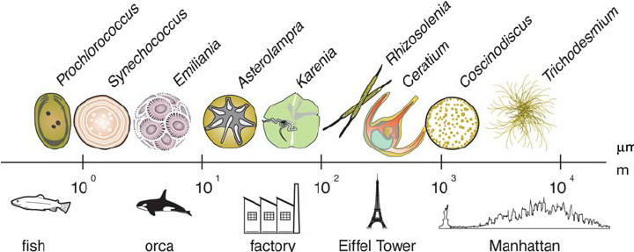
Trait-based ecology – Trait variation
Large variation in size and growth: Both are master traits as they influence many other traits (often shown by correlations between a trait and cells size or growth)
Growth
Size
Finkel et al. 2010 JPR
Litchman et al. 2007 Ecol. Lett.

Slide 12
Trait-based ecology – Trait variation
Traits vary between species (interspecific variation) and within species (intraspecific variation): Intraspecifc variation can be very large and supports rapid evolution
Half-saturation constant for nitrogen (K_{1/2})*
*This is the concentration of nitrogen where the uptake rate is 50% of the maximum. So, a lower K1/2 means less is needed to reach 50% of the max uptake rate, which means a higher affinity.
Brandenburg et al. 2018 Ecol. Lett.

Slide 13
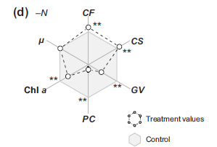
Trait-based ecology – Trait plasticity
Trait plasticity is the change of a trait within an organism: Trait or phenotypic plasticity can be assessed by exposing an organism to a change in the environment.
In other words: Difference between treatment and control:
Microcystis sp.
Colony formation
Growth
Cell size
Chlorophyll-a
Gas vesicles
Phycocyanin
Duan et al. 2021, L&O

Slide 14
Trait-based ecology – Trade-offs
What are trade-offs?
A trade-off is a negative association between two traits.
We find trade-offs both between species and within species

Slide 15
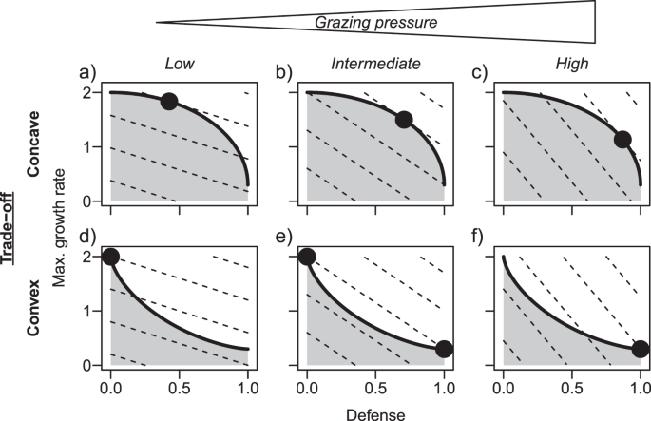
Trait-based ecology – Trade-offs
Trade-offs can have different shapes: Depending on shape and environment, there are different trait combination outcomes as result of species sorting (or selection)
Ehrlich et al. 2020 ISMEJ

Slide 16
Trait-based ecology – Trade-offs
Trade-offs can have different shapes: Depending on shape and environment, there are different trait combination outcomes as result of species sorting (or selection)
➔ Higher grazing pressure selects for stronger defense (but lower growth rate)
➔ Intermediate grazing pressure may lead to co-existence!
Ehrlich et al. 2020 ISMEJ

Slide 17
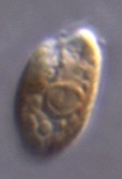
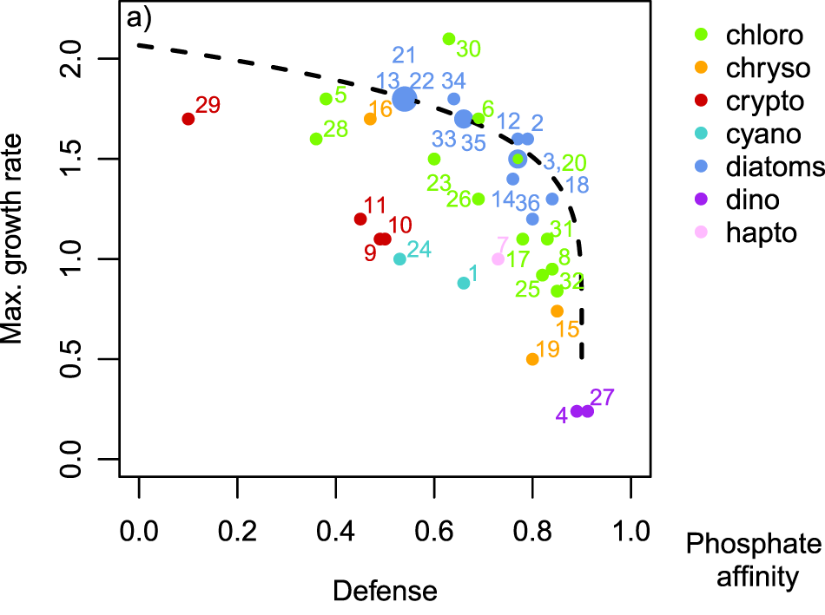
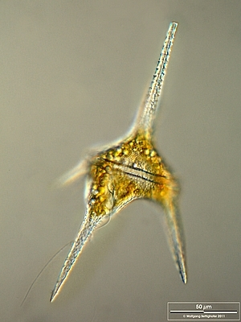
Trait-based ecology – Trade-offs
Example of a trade-off across phytoplankton groups
Rhodomonas sp.
Ehrlich et al. 2020 ISMEJ
Ceratium hirundinella (10x)

Slide 18
Trait-based ecology – Importance of trade-offs
Trade-offs facilitate biodiversity and resilience
Trade-offs prevent the existence of a single superior competitor (a.k.a. Darwinian demon) and play a central role in how populations and communities respond to changes in the environment.
Trade-offs are everywhere!
Even when there is no apparent trade-off between two traits, there will likely be trade-offs with other traits.

Slide 19
Trait-based ecology – Role of environment (last example)
Typical seasonal dynamics in freshwater: Driven by changes in the environment
Diatoms
Cyanobacteria
Green algae
Dinoflagelllates
Biomass
Jan
Feb
Mar
Apr
May
Jun
Jul
Aug
Sep
Oct
Nov
Dec

Slide 20
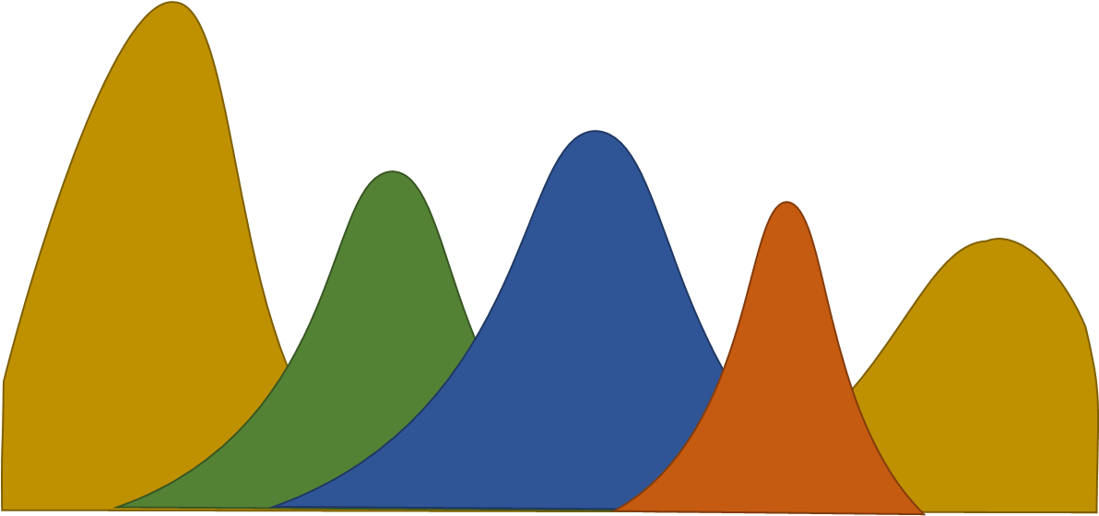
Trait-based ecology – Role of environment (last example)
Discuss with 2-3 people: What factors play a role in seasonal dynamics?
Zooplankton
Top-down
Protists
Virusses
Fish
Fungi
Bacteria
Eutrophication
Climate change
Evolution
...
Light
CO₂
Nitrogen (N)
Phosphorus (P)
Bottom-up
Silica (Si)

Slide 21
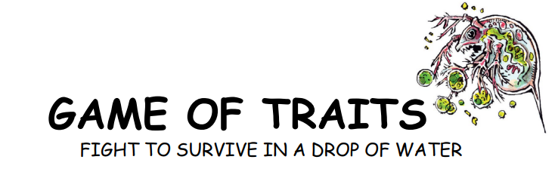
https://nioo.knaw.nl/en/projects/game-of-traits

Slide 22
Recap Trait-based Ecology
What are traits and why we study them?
Traits are characteristic of an (individual) organism
Traits vary between species (interspecific variation) and within species (intraspecifc variation), and respond to environmental changes (trait plasticity)
Provides a mechanistic understanding on ecological interactions

Slide 23
Recap Trait-based Ecology
What are traits and why we study them?
Traits are characteristic of an (individual) organism
Traits vary between species (interspecific variation) and within species (intraspecifc variation), and respond to environmental changes (trait plasticity)
Provides a mechanistic understanding on ecological interactions
Which type of traits do we find in phytoplankton?
Master traits include growth rate and cell size
Morphological traits: Colony formation, filaments, etc.
Physiological traits: Photosynthesis, nutrient uptake, toxin synthesis, mixotrophy, etc.
Behavioral traits: Motility (e.g. gas vesicles, flagellae), etc.

Slide 24
Recap Trait-based Ecology
What are traits and why we study them?
Traits are characteristic of an (individual) organism
Traits vary between species (interspecific variation) and within species (intraspecifc variation), and respond to environmental changes (trait plasticity)
Provides a mechanistic understanding on ecological interactions
Which type of traits do we find in phytoplankton?
Master traits include growth rate and cell size
Morphological traits: Colony formation, filaments, etc.
Physiological traits: Photosynthesis, nutrient uptake, toxin synthesis, mixotrophy, etc.
Behavioral traits: Motility (e.g. gas vesicles, flagellae), etc.
What is a trade-off and which ones can we find in phytoplankton?
Trade-offs are a negative association between two (or more) traits
Growth rate vs. Cell size/defense; Toxin production vs. Nutrient affinity

